Slide 1
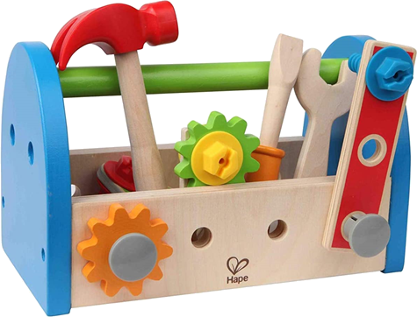
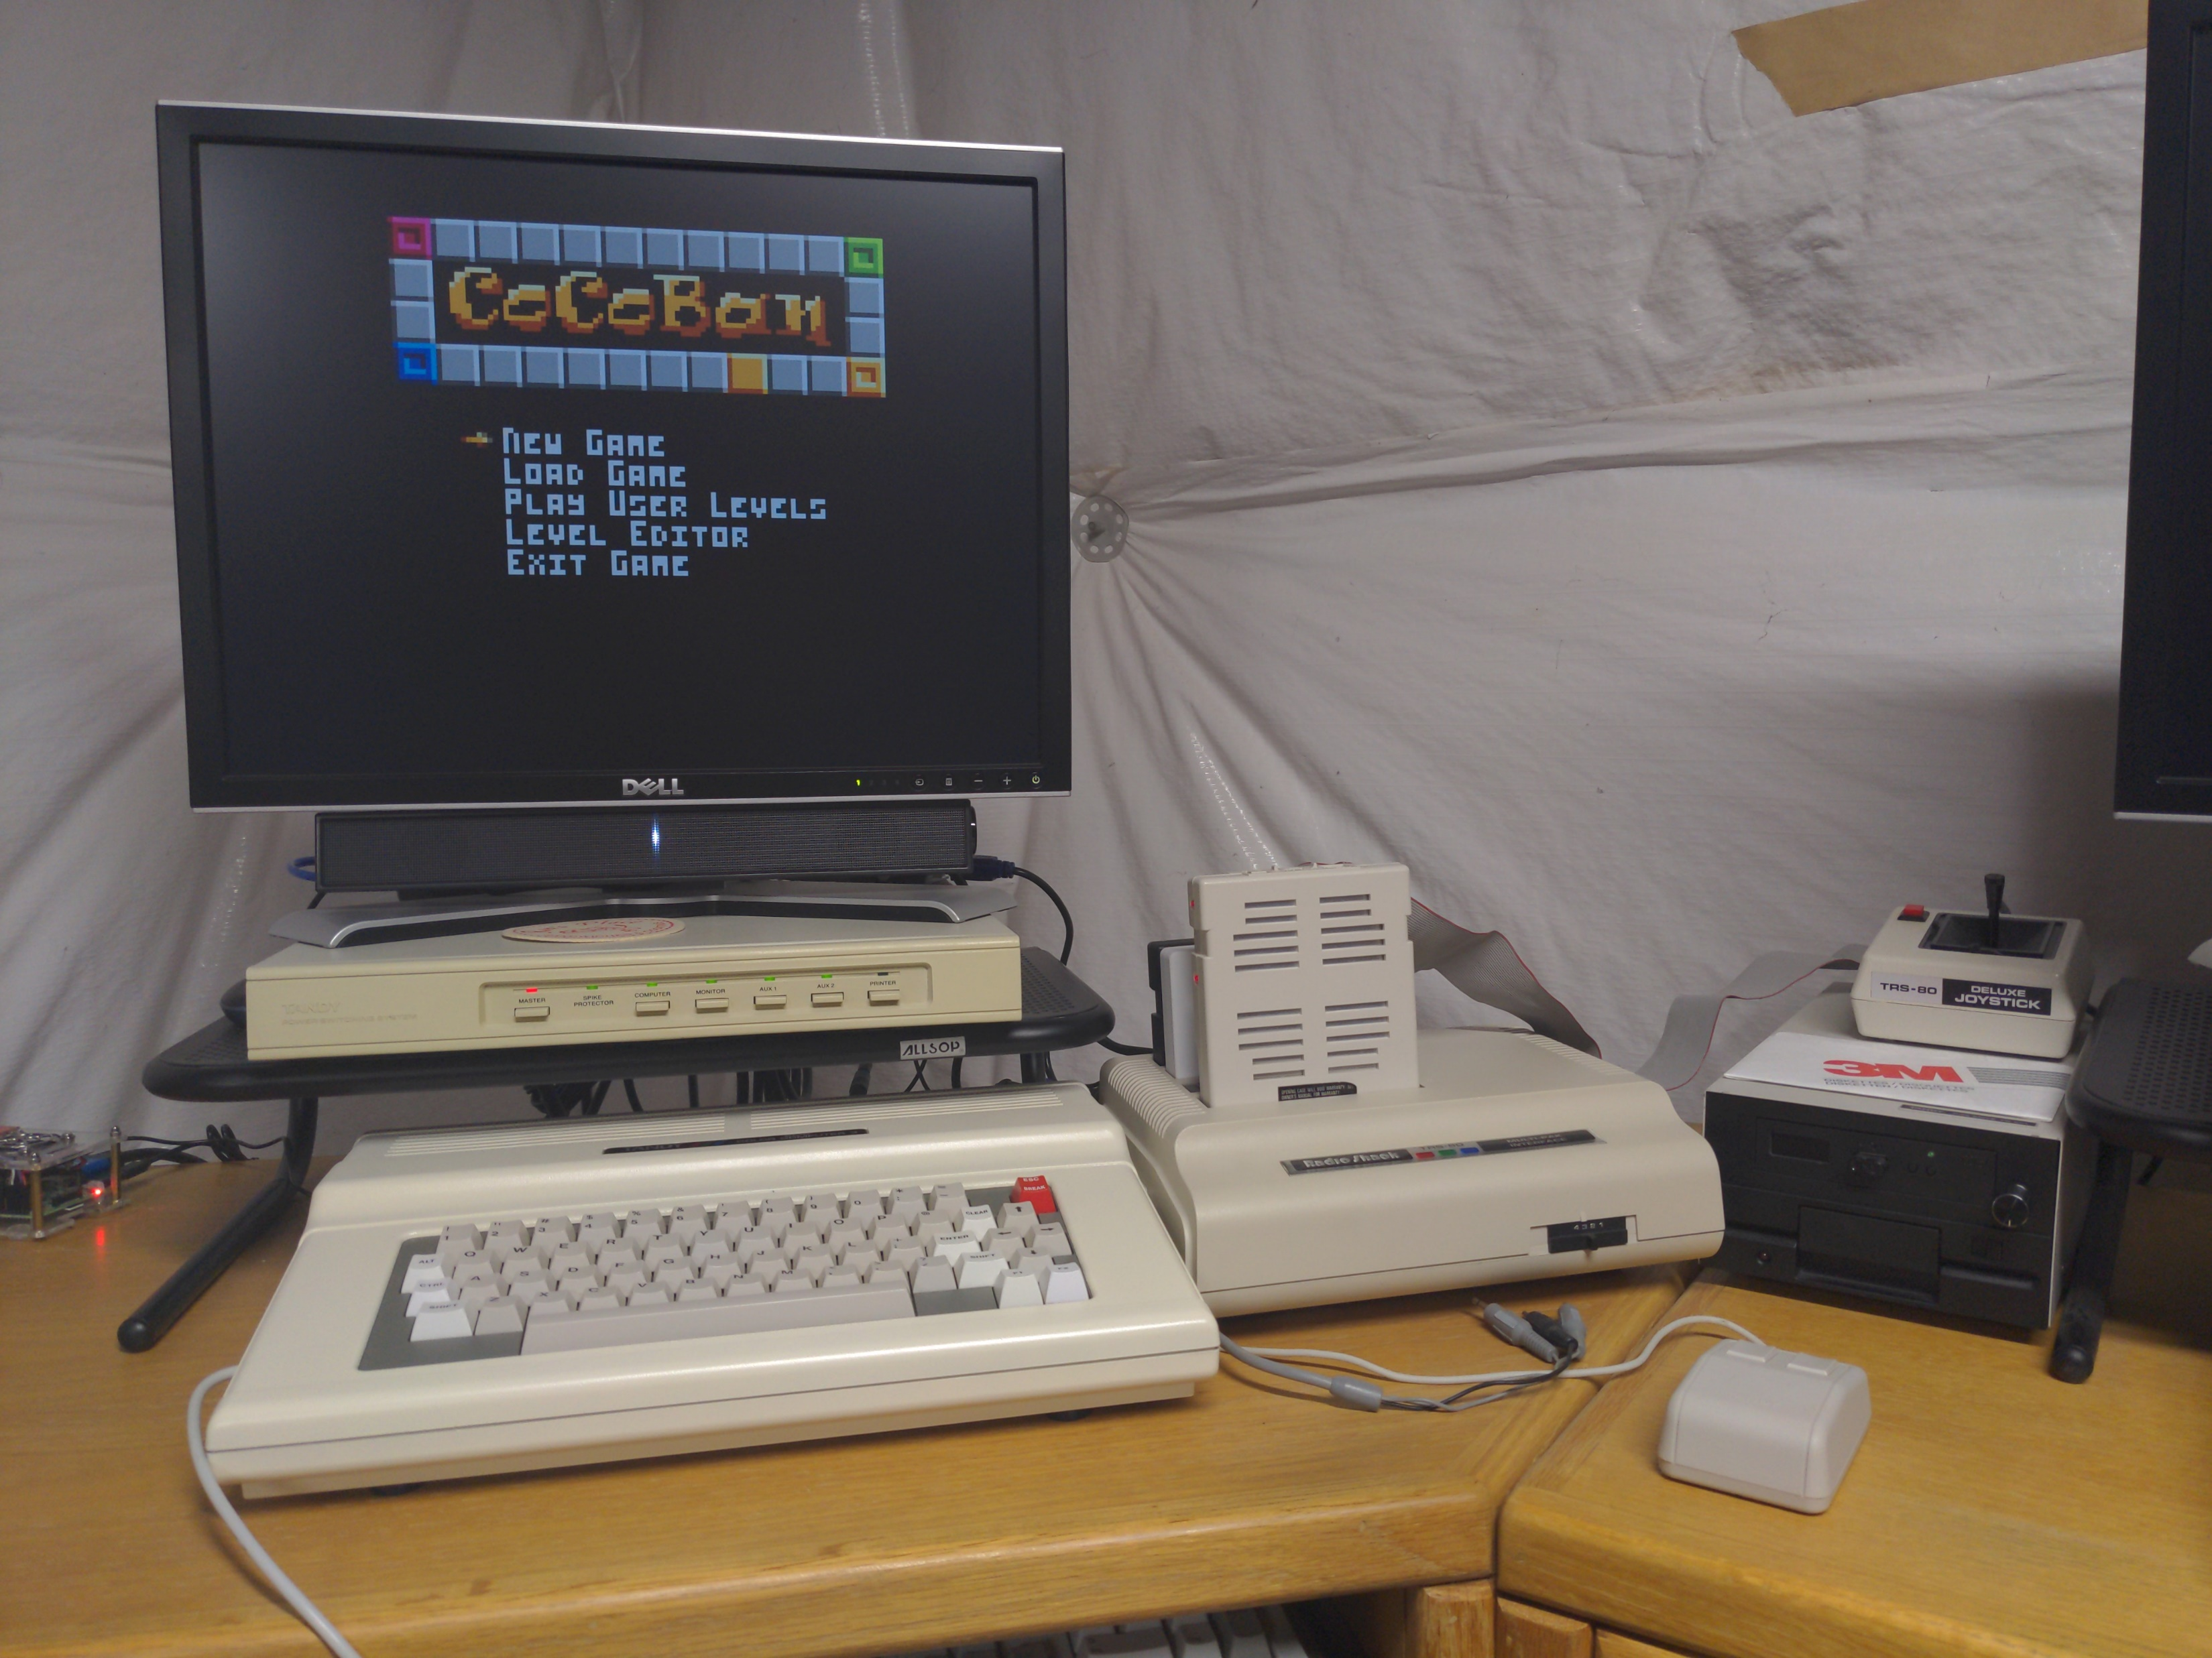
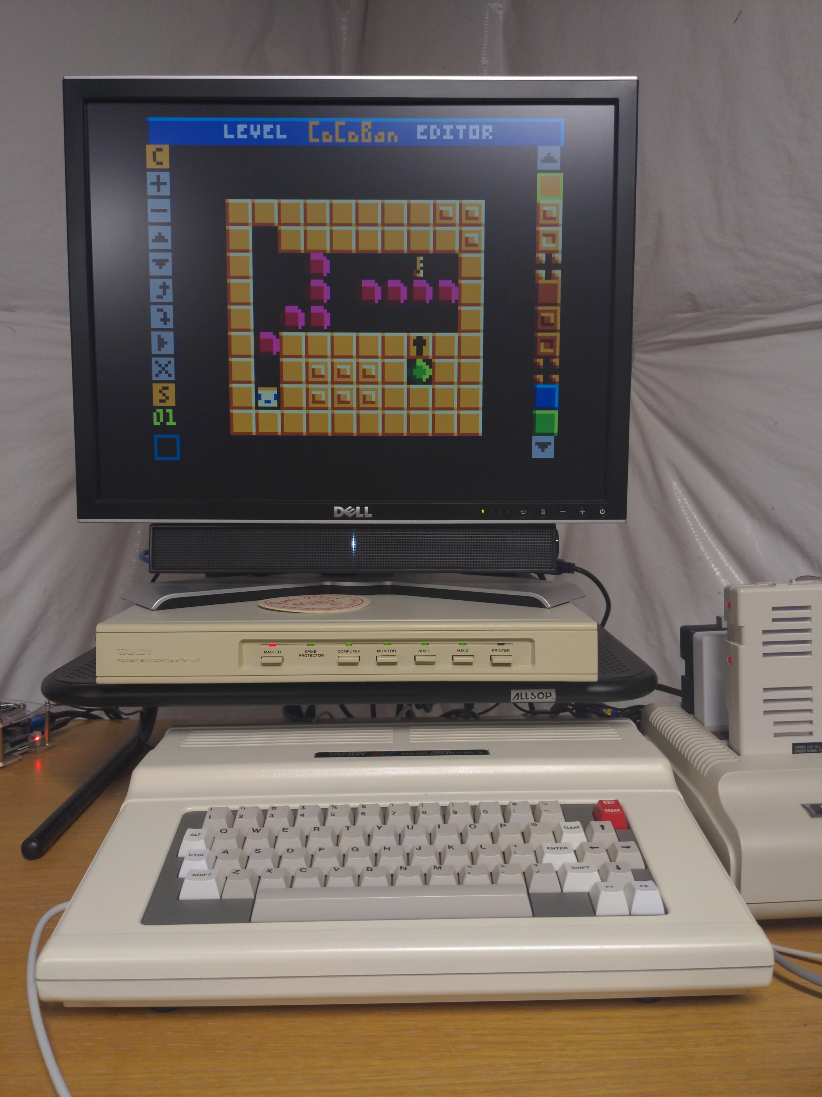
CoCo Game Development
Tools of The Trade

Slide 2
The Early Days
A touch of Redbeard history.
1986-1987 Tim gets a CoCo 3 for Christmas.
Rainbow Magazine Subscription.
Type in Programs.
Tried to make our own games and impress our friends!
HDRAW this, HPRINT that.
Too slow!
Ran out of memory.
Sever lack of tools. Everything done INSIDE the program.
Enter high school and girls! Exit the CoCo.
Learned how to play guitar and went to school for Graphics Arts.
Tools of The Trade

Slide 3
The Internet Days
The love for the CoCo resurfaces!
2008-2009 I search for CoCo 3 Emulators.
Had been using Mark Overmars’ “Game Maker” program for the PC.
Around that same time I discover coco3.com (I think).
I began to learn more about the hardware.
Started creating development tools for BASIC games:
Sprite editor.
Full screen graphics editor.
Also started POKEing around to try and speed things up with BASIC.
I was really starting to recognize the need to learn assembly.
Realization of the need for tools.
Tools of The Trade

Slide 4
Along Came a Mad Man
My assembly journey finally begins!
2014-2015 or so this random dude from Denmark says, “I will teach you
assembly.”
That day was the start of a very long friendship.
We start grinding at my first (so far only) assembly game, “Timberman.”
Tools used:
BASIC sprite editor
CoCo Max 3
Notepad
LWASM
Wimagetool
VCC Emulator
Real hardware
SDC
Tools of The Trade

Slide 5
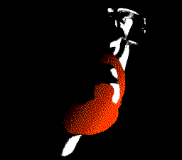
Today’s Tools
And finally, the point!
Planning, organization, patience and milestones.
Support group!
Tools:
Assembly programming book.
Hardware docs.
Graphics editor.
Sprite compiler.
Hex editor.
Spreadsheet.
Notebook, word processor, note cards, or a combo of all of them.
Text editor.
Assembler.
Compressor/ decompressor.
Emulator.
Virtual disk creation tool.
Real hardware with an SDC.
Jams!
Tools of The Trade

Slide 6
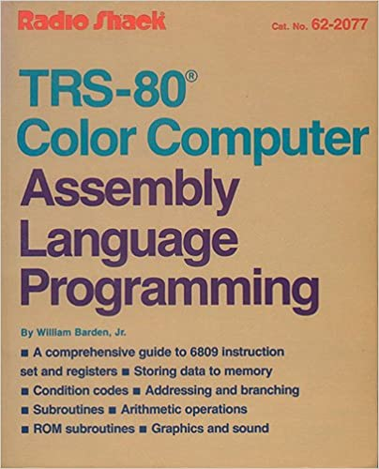
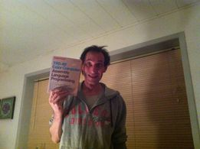
Assembly Books
“TRS-80 Color Computer Assembly Language Programming”
William Barden Jr
Limited availability for purchase.
“Motorola 6809 and Hitachi 6309 Programmer’s Reference”
Darren Atkinson
Available on the Archive.
Tools of The Trade

Slide 7
Hardware Docs
Many out there!
Chris Lomont’s “Color Computer 1/2/3 Hardware Programming”
Available at: http://lomont.org/
Computing>Software>
Unfinished.
Some flaws, but a great place to start experimenting.
I used it to develop keyboard and joystick routines.
Sock Master’s GIME Reference:
Available at: http://users.axess.com/twilight/sock/gime.html
Accurate. From the master himself!
Detailed descriptions.
Must know info for CoCo 3 programming.
Tools of The Trade

Slide 8
Graphics Editor
Many out there!
Needs to allow “indexed” color palettes.
GIMP – GNU Image Manipulation Program
Available here: www.gimp.org
It’s FREE!
Lots of FREE plugins available.
Easy to use.
Cross platform.
Tools of The Trade

Slide 9
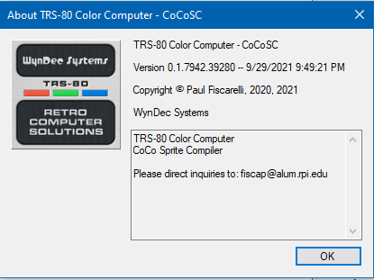
Sprite Compiler
Not so many out there!
Glen Hewlett
Nick Marentes
Paul Fiscarelli – CoCoSC
The one I use.
Still in development.
Spits out assembly code better and faster than me!
Used to compile sprites faster than a human.
Compiled sprites execute faster, but take more memory.
Also used for converting backgrounds and full screen images,
Tools of The Trade

Slide 10
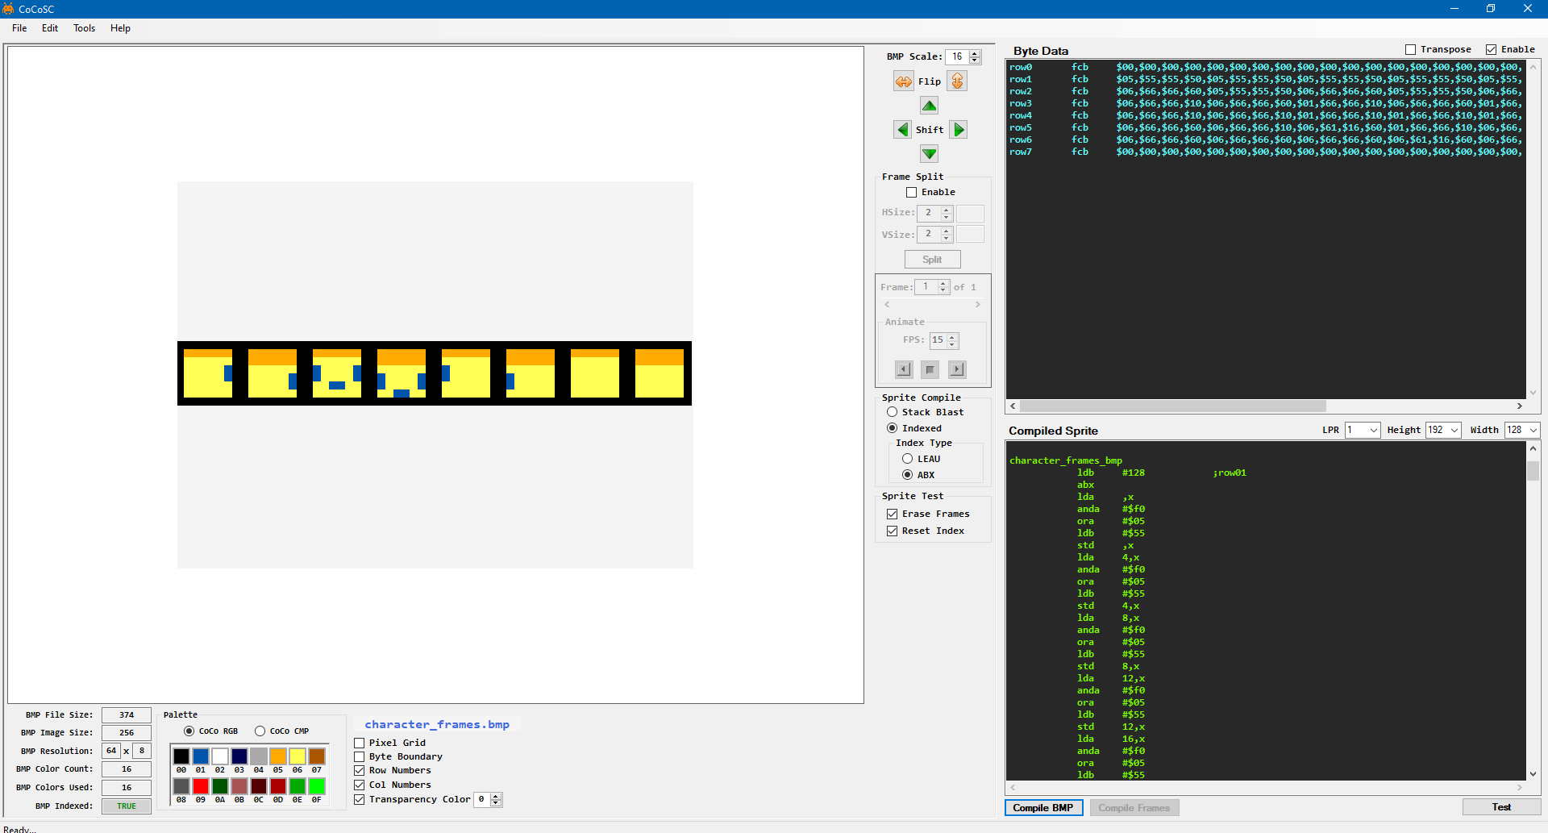
Sprite Compiler
Tools of The Trade

Slide 11
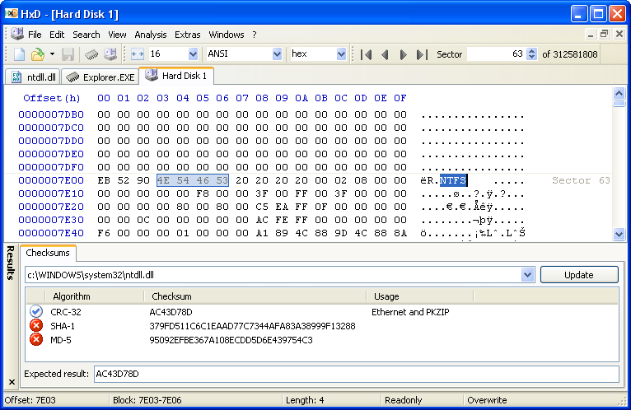
Hex Editor
Used to edit any binary files.
Strip headers from BMP files.
Add pre and post ambles to CoCo BIN files.
Other applications.
The one I use is “HxD.”
Available here: https://mh-nexus.de/en/hxd/
Tools of The Trade

Slide 12
Spreadsheet
Calculate tables.
Visually manage memory maps.
So much more!
I use Excel, but Open Office and Google Sheets work well too!
Tools of The Trade

Slide 13
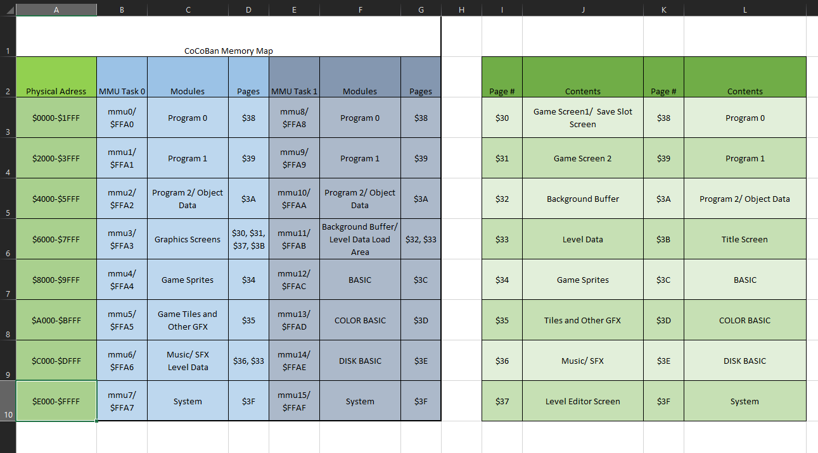
Spreadsheet
Tools of The Trade

Slide 14
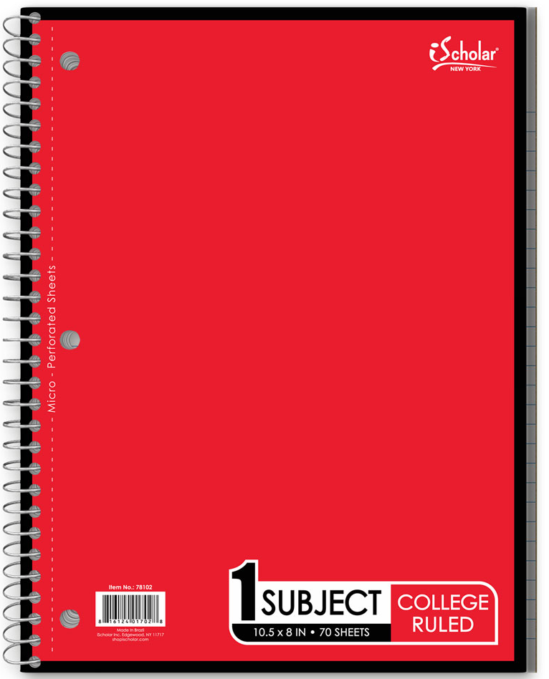
“I brought my… PENCIL!”
“Gimme something to write on man!”
Write things down and plan things out.
Do manual calculations.
Make charts or tables.
Set goals.
Where was I?
I buy dedicated notebooks.
Tools of The Trade

Slide 15
Text Editor
Several Available.
Used for editing assembly code.
Notepad comes with Windows.
Notepad++ is better for code editing and is FREE!
Available here: https://notepad-plus-plus.org/downloads/
Custom syntax coloring.
Many advanced editing features.
Great for “module” style programming.
I think it even has revision control, but I don’t use it.
Listing output console!
Assemble, execute and test code on the fly!
Tools of The Trade

Slide 16
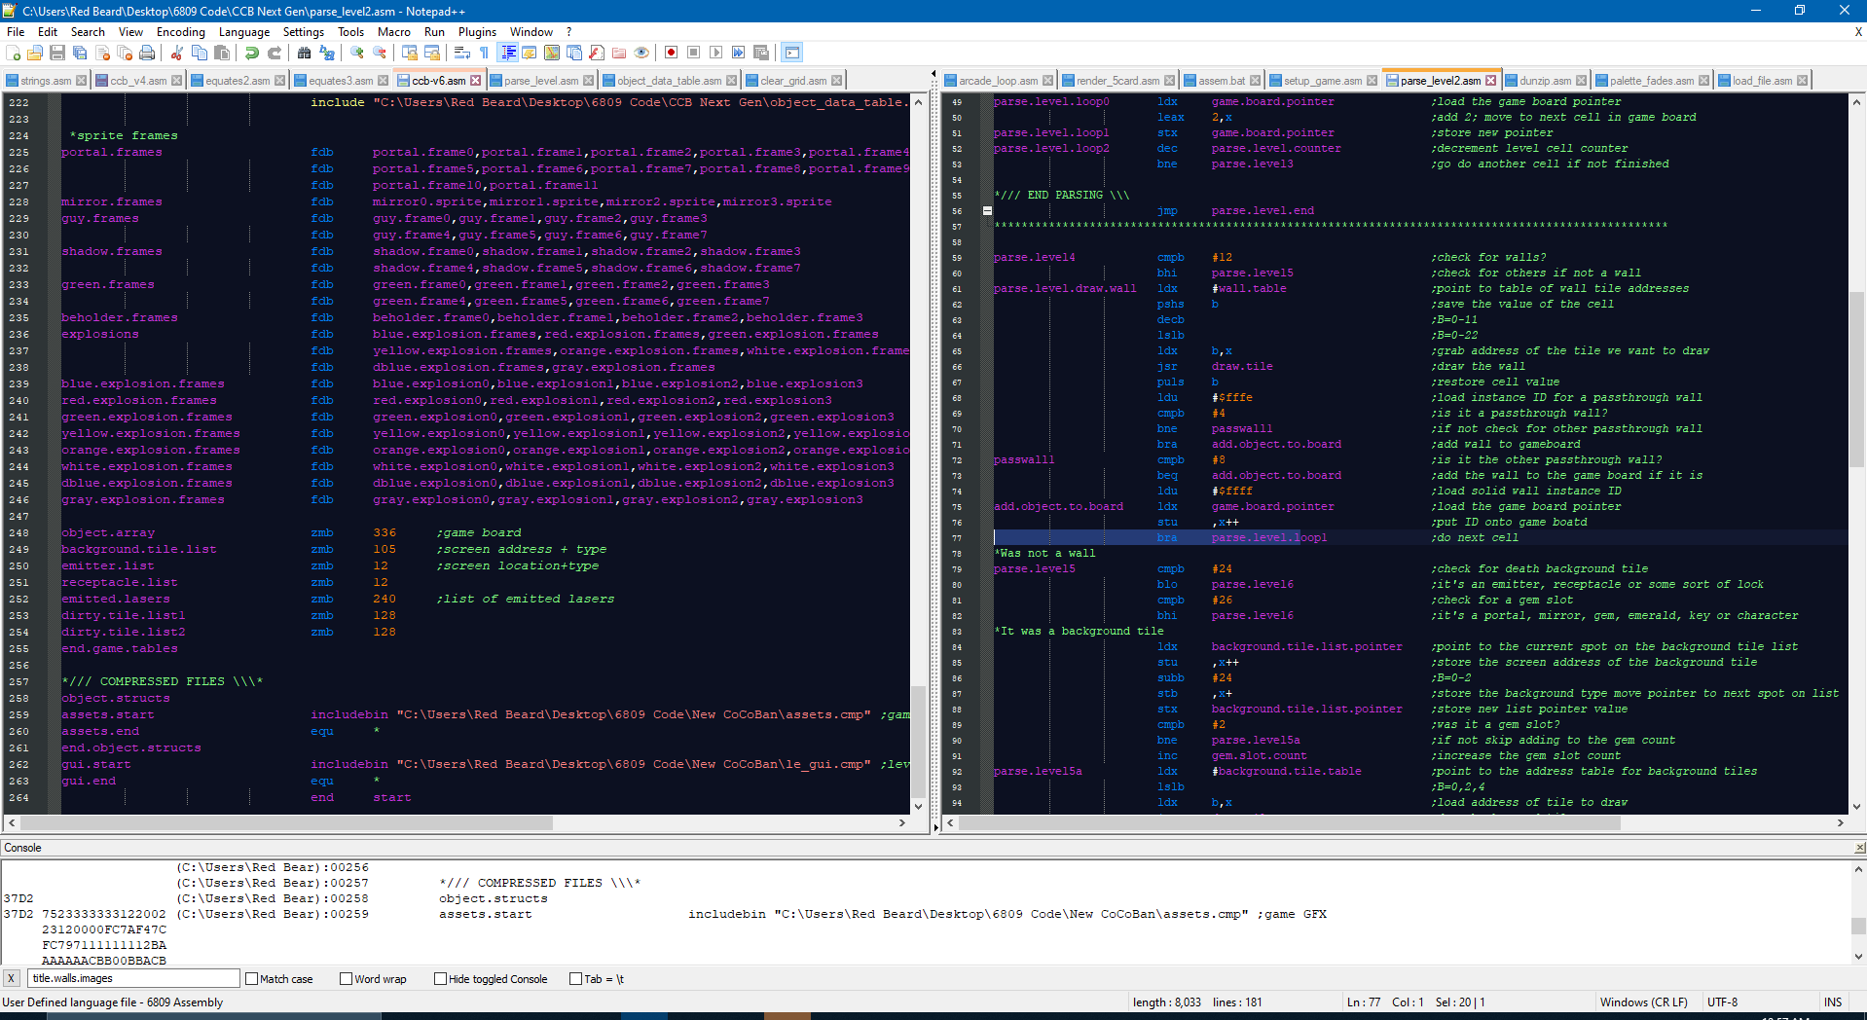
Text Editor
Tools of The Trade

Slide 17
Assembler
Quite a few available.
Used to assemble binaries from assembly code.
EDTASM (many versions)
A true classic!
Text editor and assembler in one.
Specific to the CoCo.
Available on the Archive.
LWASM
Written by William Astle.
PC based assembler.
Assembles 6309 AND 6809.
Advanced features.
Available here: http://www.lwtools.ca/
Tools of The Trade

Slide 18
Compressor/ Decompressor
Quite a few available.
Used to compress large amounts of data.
Several applications:
Sprite data
Graphics screens
Level data
Keep items compressed in memory for later use.
Decompress as needed.
Overwrite compressed data when it is no longer needed.
Makes for a smaller BIN on the disk.
I use DZIP.
Developed by Ciaran (of Xroar fame!)
Available here:
https://www.6809.org.uk/dragon/?fbclid=IwAR1isyx52PGjRgCbhdtiUbe9xmVstDqOlzaWgi0Zb_lRNWOkfrlscdm_9O0#software
Must use decompressor in your assembly program.
Tools of The Trade

Slide 19
Emulator
MAME/ MESS
Was most accurate.
Available here: https://www.mamedev.org/
Great debugger!
Disk image creator too
VCC
Quickest to execute.
CoCo 3 exclusive.
Was less accurate to real hardware, but has been well enhanced recently!
Able execute BIN files by just dragging them on top of the icon.
Available here: https://github.com/VCCE/VCC
Xroar
I used it for CoCo 2 emulation and it was fantastic!
Available here: https://www.6809.org.uk/xroar/
Tools of The Trade

Slide 20
Virtual Disk Creator
Used to create virtual disks the CoCo can read.
Store your program or data for your program!
I hear there are quite a few available.
I use Windows Image Tool, it comes with MAME/ MESS
Tools of The Trade

Slide 21
Real Hardware With a SDC
Used to check everything works correctly at major milestones!
Sometimes I outsource real hardware testing.
Nothing beats the real thing!
Tools of The Trade

Slide 22
Jams!
I listen to instrumental music while programming.
Whatever it is that helps you focus and feel comfortable, DO IT!
Tools of The Trade

Slide 23
Support Group!
You just can’t do it alone.
Everything’s easier with a good team!
Everything is more fun with great friends!
Other people can teach you many things!
Tools of The Trade

